Slide 1
Introduction Microsoft Intelligent App Workshop
<Name of Trainer>
<Title of Trainer>

Slide 2

Agenda
Day 1
Intro Intelligent Apps: The times are changing
DevOps in the Microsoft Cloud
Microservices, PaaS and Serverless Computing
Monitoring and Telemetry
Day 2
Storage Options in Microsoft Azure
Docker Containers in Microsoft Azure
Machine Learning and Cognitive Services
New UI Paradigms

Slide 3
Organization
Day 1
Arrival, Coffee: 9:30am – 10:00am
Start: 10:00am
Morning Break: 11:15am – 11:30am
Lunch: 12:45am – 1:30pm
Afternoon Break: 3:00pm – 3:30pm
End: 5:00pm
Day 2
Start: 9:30am
Morning Break: 11:00am – 11:15am
Lunch: 12:45am – 1:30pm
Afternoon Break: 2:45pm – 3:00pm
End: 4:30pm

Slide 4

Your Trainer
<Add an introduction of the trainer here>

Slide 5
Prerequisites for Hands-on Labs
Windows 10 Pro or Enterprise 64bit
Incl. virtualization and Hyper-V
Most of the labs can be done on macOS and Linux, too (not technical support for this platform is available during training)
Visual Studio Enterprise 2017
You can use the free trial for this workshop, required components:
.NET Desktop development
Universal Windows Platform Development
ASP.NET and web development
Azure development
Node.js development
.NET Core development
Redgate ReadyRoll Core

Slide 6
Prerequisites for Hands-on Labs
Active Microsoft Azure Subscription with admin privileges
You can use the free trial for this workshop
Incl. Azure Powershell (installation guide)
Text Analytics subscription
Get free evaluation key
SQL Server Management Studio (SSMS)
Free download

Slide 7

Prerequisites for Hands-on Labs
Docker for Windows
Part of Docker Community Edition → free download
Download (docker pull …) the following images prior to the training:
Windows:
microsoft/aspnet
Linux:
microsoft/dotnet:2-sdk
microsoft/dotnet:2

Slide 8
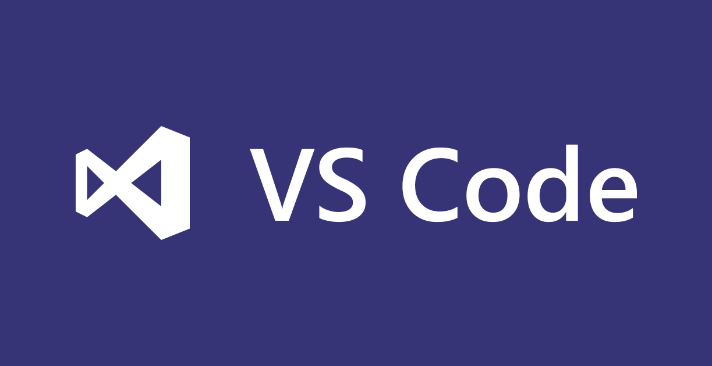
Prerequisites for Hands-on Labs
Visual Studio Code
Free download
Required/recommended plugins
Language Support for Java™ by Red Hat
Java™ Debug Extension for Visual Studio Code
Azure Resource Manager Tools
Azure Tools for Visual Studio Code
Azure Functions Tools – Extensions for VS Code
Docker
REST client of your choice
E.g. Postman, Insomnia

Slide 9

Prerequisites for Hands-on Labs
Java™ JDK
Download
Node.js
Free download
Bot Framework
Bot Framework Emulator
Bot Framework SDK and tools
See also installation tips in hands-on lab

Slide 10
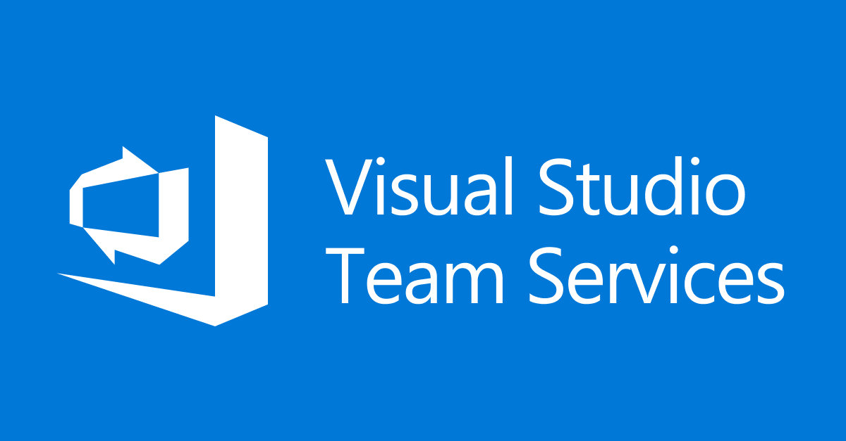

Questions?
Azure

